Slide 1
Integrated Care for Dual Eligibles
Geriatric Social Workers of Southeast Michigan
July 12, 2012

Slide 2
Integrated Care for Dual Eligibles
Context
ACA
Innovation programs
TSA Involvement
Integrated care programs
Definition
Options
National presence
Michigan’s plan

Slide 3
Context: The Affordable Care Act
The Center for Medicare-Medicaid Innovation
Health care innovation through finding new ways to pay for and provide care
Lower costs
The Medicare-Medicaid Coordination Office
Seamless, high-quality healthcare access for dual eligibles
Cost-effective system

Slide 4
Context: Innovation Programs
Accountable Care Organizations
Bundled Payments for Care Improvement
Comprehensive Primary Care Initiative
Financial Alignment Initiative
FQHC Advanced Primary Care Practice Demonstrations
Graduated Nurse Education Demonstration
Health Care Innovation Awards
Independence at Home Demonstrations

Slide 5
Innovation Programs (cont.)
Initiative to Reduce Avoidable Hospitalizations Among Nursing Facility Residents (3021)
Innovation Advisors Program
Medicaid Emergency Psychiatric Demonstration
Medicaid Incentives Program for the Prevention of Chronic Disease
Partnership for Patients
CCTP (3026)
Strong Start for Mothers and Newborns
State Demonstrations to Integrate Care for Dual Eligible Individuals

Slide 6
Context: Involvement of TSA, AAA 1-C
Area Agency on Aging and MI Choice Waiver Agency (1915c Waiver)
Research study conducted in partnership with AAA 1-B
Report published in November 2011:
Lessons Learned from other states, recommendations
Statewide Public Input process
Public Input Hearings
Request for Information
Workgroups: Care Coordination and Assessment; Education, Outreach, and Enrollee Protections; Performance Measurement and Quality; Service Array and Provider Network

Slide 7
Context: Dual Eligibles
Experience higher rates of chronic physical and mental/cognitive disease than other Medicare beneficiaries.
90+% of dual eligibles 65 years of age or older have at least one chronic physical condition.
Source: Kasper, Watts, & Lyons, 2010

Slide 8
Context: Dual Eligibles
Michigan Dual Eligibles Medicaid Data, 2010
Sources: Centers for Medicare & Medicaid Services, 2011a; Michigan Department of Community Health, 2010

Slide 9
Context: Dual Eligibles
239,262 dual eligible individuals in Michigan
2010 estimated spending on Michigan’s dual eligibles:
Medicare: $4.1 billion
Medicaid: $3.6 billion
Total: $7.7 billion
Sources: Centers for Medicare & Medicaid Services, 2011a; Michigan Department of Community Health, 2010

Slide 10
Context: Medicare & Medicaid
Services paid by Medicare | Services paid by Medicaid
Acute care (hospital) services | Medicare cost sharing (Part A & B deductibles, Part B premiums & coinsurance)
Outpatient, physician, & other supplier services | Hospital & skilled nursing facility services if Part A benefits are exhausted
Skilled nursing facilities | Nursing home care
Home health care | Home health care not covered by Medicare when person qualifies as needing nursing home care
Continued…
Source: Medicare Payment Advisory Commission, 2010

Slide 11
Context: Medicare & Medicaid
Services paid by Medicare | Services paid by Medicaid
Prescription drugs | Portion of prescription drug costs
Dialysis | Transportation to medical appointments
Durable medical equipment | Durable medical equipment not covered by Medicare
Hospice | Optional services: Dental Vision Hearing Home- and community-based services (MI Choice in Michigan) Personal care Home health care when person does not qualify for Medicare and does not need nursing home care
Source: Medicare Payment Advisory Commission, 2010

Slide 12
Context: Centers for Medicare & Medicaid Services (CMS) Award
15 states receive ≤$1 million to design and implement an integrated care model
Requires participating states to align the full range of Medicare and Medicaid primary care, acute care, behavioral health, and long-term supports and services
Source: Centers for Medicare & Medicaid Services, 2011

Slide 13
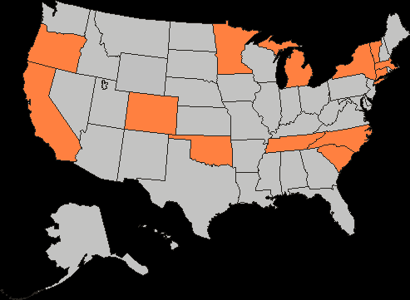
Context: CMS Award
CMS award recipients:
California
Colorado
Connecticut
Massachusetts
Michigan
Minnesota
New York
North Carolina
Oklahoma
Oregon
South Carolina
Tennessee
Vermont
Source: Centers for Medicare & Medicaid Services, 2011

Slide 14
Context: CMS Award
There are now 26 states with plans to Integrate Care for Dual Eligibles
Those states that did not participate under the State Demonstrations grant are participating under the Financial Alignment Initiative

Slide 15
Integrated Care Programs
Single entity responsible for:
Financing dual eligibles’ care
Coordinating dual eligibles’ care
Source: Medicare Payment Advisory Commission, 2010

Slide 16
Integrated Care Programs
Without Integrated Care | Integrated Care
Three ID cards: Medicare, Medicaid, and prescription drugs | One ID card
Three different sets of benefits | One set of comprehensive benefits: primary, acute, prescription drug, long-term care supports and services, and behavioral health services.
Multiple providers who rarely communicate | Single and coordinated care team
Health care decisions uncoordinated and not made from the patient-centered perspective | Health care decisions based on the individual’s needs and preferences
Serious consideration for nursing home placement; Medicare/Medicaid only pays for very limited home health aide services | Availability of flexible, non-medical benefits that help individuals stay in their homes
Source: Gore, 2011, p. 5

Slide 17
Integrated Care Programs
Options in developing integrated care models:
Managing entity: Managed care organization or accountable care organizations v. provider
Population: All dual eligibles v. subset of dual eligibles
Enrollment: Mandatory v. voluntary
Service area: Statewide v. regional
Benefits included: Medicare and Medicaid primary care, acute care, behavioral health, and/or long-term supports and services

Slide 18
Michigan’s Process
https://janus.pscinc.com/dualeligibles/
Respond to CMS
Public Hearings
Stakeholder Interviews
Request for Information
Workgroups
Ongoing Comments

Slide 19
Michigan’s Plan, Subject to Change
Managing entity: Integrated Care Organizations (ICO) and Prepaid Inpatient Health Plans (PIHP)
Population: All dual eligibles
Enrollment: Passive Enrollment, with option to opt out
Service area: Statewide, with phased implementation
Benefits included: Medicare and Medicaid primary care, acute care, behavioral health, and long- term supports and services
Implementation date: July 2013
Expected enrollment: 220,050 individuals
Sources: Centers for Medicare & Medicaid Services, 2011a; Michigan Department of Community Health, 2010

Slide 20
“Care Bridge”
Coordination between the ICO and PIHP
Responsibility of care coordinator to draw upon expertise of multidisciplinary team
Vague

Slide 21
Phased Implementation
Several regions will be established based on number of dual eligibles
Phase 1: All beneficiaries except those needing long term care services and those who have intellectual/developmental disability
Phase 2: Beneficiaries needing long term care services
Phase 3: Beneficiaries with intellectual/developmental disabilities

Slide 22
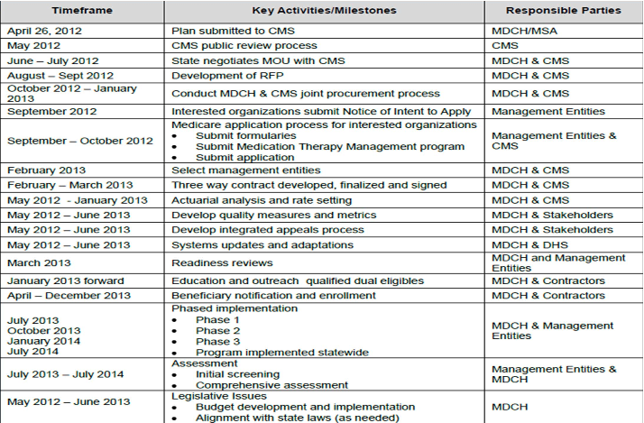
Source: Presentation by Community Catalyst Care Advocacy Project 2012

Slide 23
Current Environment
Medicaid Managed Care Organizations
Michigan Association of Health Plans
Quality
HEDIS, CAHPS, HOS, state quality measures
“5 star rating”
Accreditation

Slide 24
Challenges
Collaboration and duplication
Enrollment/time frame
Case coordination
Person-centered
Waiver and Home Help
Expanded Medicaid
Regions

Slide 25
Opportunities
Collaboration between organizations who have not historically worked together
Strong provider networks and oversight
Enhanced benefits for those enrolled

Slide 26
What should you be doing?
Advocating
Ongoing stakeholder engagement
Stay Aware

Slide 27
For Additional Information:
Center for Medicare-Medicaid Services
Center for Medicare-Medicaid Innovation
The Medicare-Medicaid Coordination Office
Michigan Department of Community Health
Public Sector Consultants
Center for Health Care Strategies (CHCS)
Integrated Care Resource Center
Consumers for Healthcare

Slide 28
Maggie Watson, Planning and Programs Manager
The Senior Alliance, AAA 1-C
Mwatson@tsalink.org
734.727.2031

Slide 29
References
Center for Health Care Strategies, Inc. (2010). States with fully integrated care programs for dual eligibles. Retrieved from http://www.chcs.org/usr_doc/ICP_State-by-State_Dashboard.pdf
Centers for Medicare & Medicaid Services. (2011a). State demonstrations to integrate care for dual eligible individuals design contracts: Summary of state’s initial design concepts, Michigan. Retrieved from http://www.cms.gov/medicare-medicaid-coordination/downloads/CMSMMCODualsDemoStateSummaryMI.pdf
Centers for Medicare & Medicaid Services. (2011b). State design contract summaries. Retrieved from http://www.cms.gov/medicare-medicaid-coordination/05_StateDesignContractSummaries.asp#TopOfPage
Gore, S. (2011, June 14). Achieving higher quality and cost-effective care: State innovations for dual eligibles and individuals accessing long-term supports and services. Presentation at Mini-Summit III: Long-Term Care and Dual Eligibles Medicaid Congress 2011.
Medicare Payment Advisory Commission. (2010). Report to the Congress: Aligning incentives in Medicare. Retrieved from http://www.medpac.gov/documents/Jun10_EntireReport.pdf
Michigan Department of Community Health. (2010). Michigan's response to CMS solicitation: State demonstrations to integrate care for dual eligible individuals (Solicitation No. RFP-CMS-2011-0009). Retrieved from http://www.ahcancal.org/facility_operations/medicaid/Documents/1.31.11%20Michigan%20- %20CMS%20Duals%20RFP.PDF
Kasper, J., Watts, M. O., & Lyons, B. (2010). Chronic disease and co-morbidity among dual eligibles: Implications for patters of Medicaid and Medicare service use and spending. Washington, DC: The Henry J. Kaiser Family Foundation.

